Slide 1
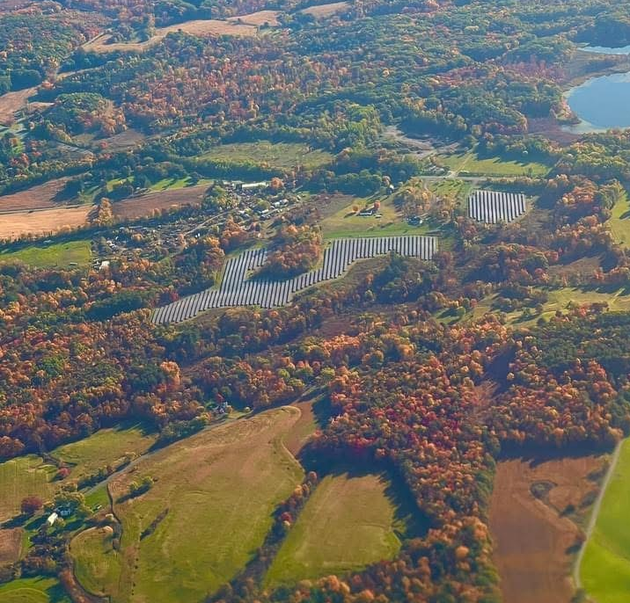
Representing Large-Scale Renewable Developers before ORES
Laura Bomyea Darling, Esq.
Partner
Young / Sommer llc
ATTORNEYS AT LAW
Executive Woods
Five Palisades Drive
Albany, NY 12205
ldarling@youngsommer.com
www.youngsommer.com
New York State Bar Association Environmental & Energy Law Section
Hot Topics in Siting Renewable Energy Facilities In New York
March 5, 2025

Slide 2
New York’s “One Stop” Permitting Regimes
Generating Facilities
PSL Article VIII (1972-79; reenacted 1978-89)
PSL Article X (1992-2002)
Local Permitting (2002-2012)
PSL Article 10 (2012-2021)
NY Executive Law Section 94-c (2021-2025)
PSL Article VIII (2025-Present)
Transmission Facilities
PSL Article VII (1970-Present*)(*gas only, eff. 2025)
PSL Article VIII (Beginning mid-2025)(electric only)

Slide 3
Why Have “One Stop” Permitting?
In his memorandum on the 1972 enactment of Article VIII, 7 Governor Nelson Rockefeller emphasized the need for a centralized permitting process to "replace the current uncoordinated welter of approvals, procedures and agencies that have virtually paralyzed the construction of needed new power plants." McKinneys' 1972 Session Laws of NY, at 3391.
The centralized siting process available through Article VIII and its predecessor statutes provides a "single forum to resolve and balance interests and objections, and to foreclose single issue objectants, including local governments, which in the spirit of NIMBY (Not In My Back Yard) often act to prevent adequate power supplies to be available for the citizens of the State or force power plants to be located where they may incur unnecessary additional costs to the rate paying public or present a more adverse environmental impact rather than at locations where the externalized costs of such plants may be properly balanced." Nash Metalware Co., Inc. v. Council of City of New York, 14 Misc.3d 1221(A), 25 (NY Sup., NY County 2006).

Slide 4
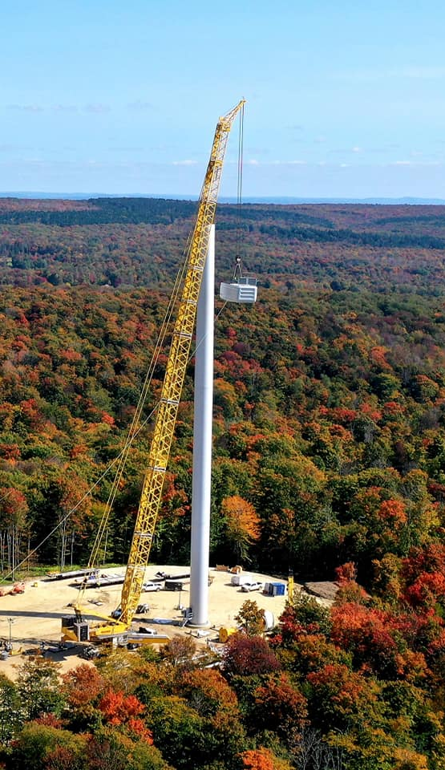
NY’s Market-Driven Energy Policy
NY’s Climate Leadership and Community Protection Act (CLCPA), Clean Energy Standard, and Reforming the Energy Vision (REV) initiatives have relied on NY’s aggressive renewable targets, NYSERDA REC procurement structures and other policy choices aimed at fostering a competitive market for renewables.
Market participants face substantial uncertainty:
Tariffs
Federal Action/Inaction
Supply Chain Disruptions
Rising Costs
Article 10 Projects
Permitted: 18 (2012-2021)
Built/Under Construction: 8 built (5 wind, 3 solar) / 2 Under construction (2 wind)
First renewable project built under A10, Cassadaga Wind, COD 2021
ORES Projects
Permitted: 20
Built/Under Construction: 1 Built / 1 Under Construction (both solar)
First renewable project under 94-c, Morris Ridge Solar Energy Center, COD 2024
Renewable projects granted permits cannot translate to renewable projects constructed if projects are not financeable.

Slide 5
ORES Permitting – Improvements and Challenges
Uniform Standards and Conditions (USCs)
Substantive and Significant Standard for Adjudicable Issues
Process/Procedural Milestones (Completeness determinations, etc.)
Local Law Approach
Mitigation Requirements
New/Changing Interpretations

Slide 6
Article VIII Pending Changes
Permit Expiration
Section 1101-3.1(i): “The Siting Permit will automatically expire if the facility does not achieve commencement of commercial operation within three (3) years from the date of issuance.” [emphasis added]
New Pre-Application Requirements and Timelines
New consultation requirements
New restrictions on timing between completion of pre-application activities and filing of Application– expected to lengthen pre-application process by 4-6 months
New noise study and visual mitigation maintenance requirements
Improvements to compliance process
Unclear how changes will apply to Projects at various stages of prior process

Slide 7
Contact Information
Laura Bomyea Darling, Esq.
Partner
Young / Sommer llc
ATTORNEYS AT LAW
Executive Woods, Five Palisades Drive, Albany, NY 12205
Phone: (518)438-9907 Ext. 249
ldarling@youngsommer.com
www.youngsommer.com

